Slide 1
Maximizing Profitability Through Smart Pricing Presentation

Slide 2
Agenda
Introduction
Objectives:
Step 1 Model development
Step 2 Finding the best Model
Step 3 Calculate absolute percent error
Step 4 Model the business using Power model
Summarize
Final conclusion

Slide 3
Introduction
Business problem:
Top Good Pest Zapper is company that manufactures electric pest zapper. This year, they are going to market and sell their product by themselves instead of through a partner. Due to highly competitive market, Top Good wants to use statistical model to navigate their pricing and marketing strategies.

Slide 4
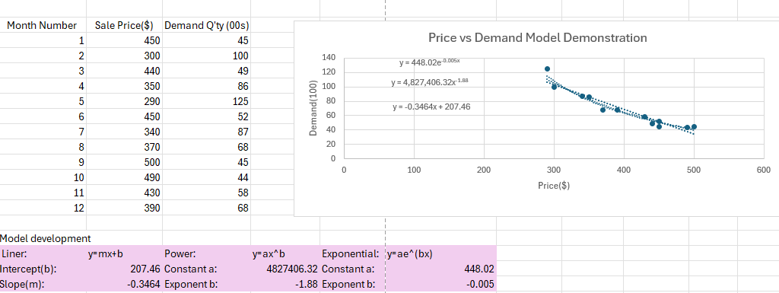
Step 1 Model development
Based on historical data of sale prices and demand throughout last year, the market team develop three predicting models to compare and select the best model.
Models: Linear, power, exponential

Slide 5
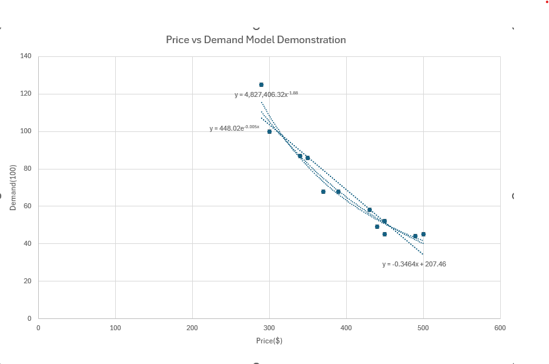
Step 2 Finding the best model
Findings:
The left chart shows the line graphs from Linear, Power, and Exponential Models.
It seems Power model is more accurate align with the actual demand.

Slide 6
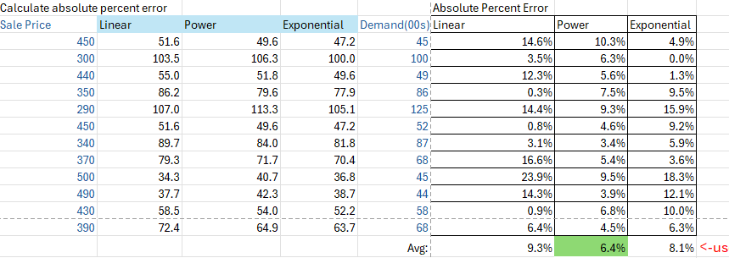
Step 3 Calculate Abs Percent Error
Findings:
Among the three regression models, Power model has the smallest absolute percent error, meaning we can rely on this model for further actions.

Slide 7
Step 4 Model the Business(Power model)
y=ax^b
a = 4827406.32
b = -1.88
x = price
Findings:
The graph shows profit change over the price range from $250 to $850 and a fixed cost $250.

Slide 8
Summarize
Used techniques: MS Excel (graph, VLOOKUP ), PowerPoint
Best predictive model: power model
Selling unit of 3640 (demand) will maximize profit, too less or too more is not recommended.
Pricing the product at $530 per unit will maximize annual profit.
Constrain: optimal pricing and demand quantity subject to change if the cost of unit changes.

Slide 9
Thank you
Lei Liu
408-805-6749
lauraliu1117@gmail.com

